Slide 1

Smart Lens
Chitrank Mishra
Prajwal Singla
Rachit Goel

Slide 2
CONTENTS
Part 01
Part 02
Part 03
Part 04
Idea
Concept
Demostration
Gratitude

Slide 3
01
Idea
Seeing the problem of looking at the screen for random tasks innovated us to design this special bluetooth powered smart lens which can be connected to different types of devices (mobiles for the time being) ex. multimeter, industrial meter controls, stopwatch etc.

Slide 4
02
Concept
We are using the principle of reflection and refraction to obtain the image of the oled on the eye lens.
We are receiving notification only for incoming call on the screen but it can be further expanded in future by making the specialized Android app.

Slide 5
03
Demonstration

Slide 6
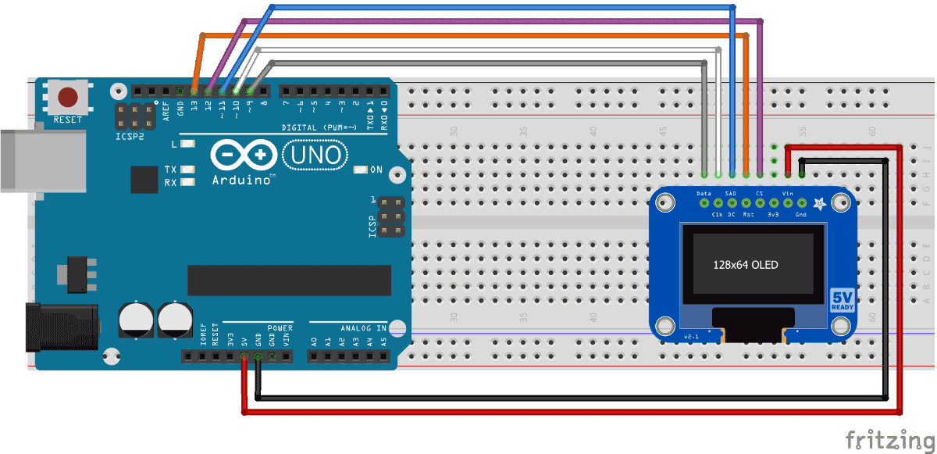
03
Demonstration
Interfacing OLED

Slide 7
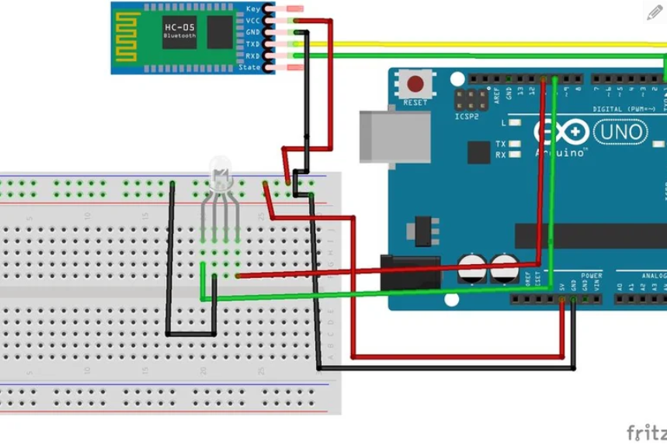
03
Demonstration
Interfacing Bluetooth HC-05

Slide 8
THANK YOU

